Slide 1
Predicting AI Job Salaries using Neural Networking and NLP
By-Nuren Perera(SCU/PDP/AI/G2/01)
Notes:
Good Morning everyone I will be presenting you about my project on “” ””

Slide 2
Content
Dataset Overview
Project Objective
Source Code Preview
Importing Libraries
Data Loading
Data Spliting
Data Preprocessing
Building the Model
Model Training and Evaluation
Scatter Plot (Actual vs Predicted)
Conclusion

Slide 3
Dataset Overview
https://www.kaggle.com/datasets/pratyushpuri/global-ai-job-market-trend-2025/code
The AI & Data Job Salaries and Skills Dataset 2024-2025 is synthetically prepared and provides a detailed, global overview of job listings in artificial intelligence, data science, machine learning, and related fields. This dataset aggregates job postings from October 2024 to July 2025, capturing a wide spectrum of roles, required skills, compensation, and organizational attributes across multiple countries and industries.
With over 15,000 entries, each record details the job title, salary (in USD and local currency), experience level, employment type, company location and size, remote work ratio, required technical skills, education and experience requirements, industry, posting and application dates, job description length, benefits score, and company name.
Notes:
The dataset we're using contains job postings in the AI domain. It includes information such as job title, required skills, education requirements,
years of experience, and salary in USD and more from October 2024 to July 2025.
Additionally, this data set contains recordings from over 15000 entities which would provide valuable information for the model.

Slide 4
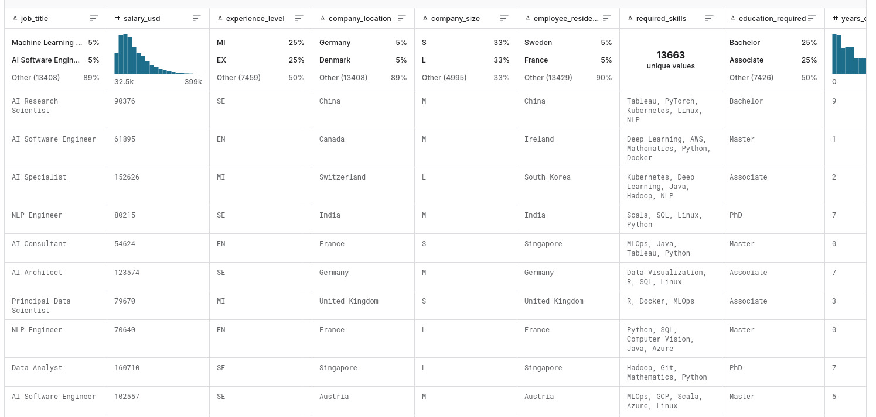
Project Overview
To predict AI job salaries (salary_usd) using:
required_skills (text)
education_required (categorical)
job_title (categorical)
years_experience (numeric)
Notes:
The objective of the project is to build a machine learning model that predicts salary (in USD) for AI-related job roles using structured and unstructured features from a dataset, combining natural language processing (NLP) and deep learning.*

Slide 5
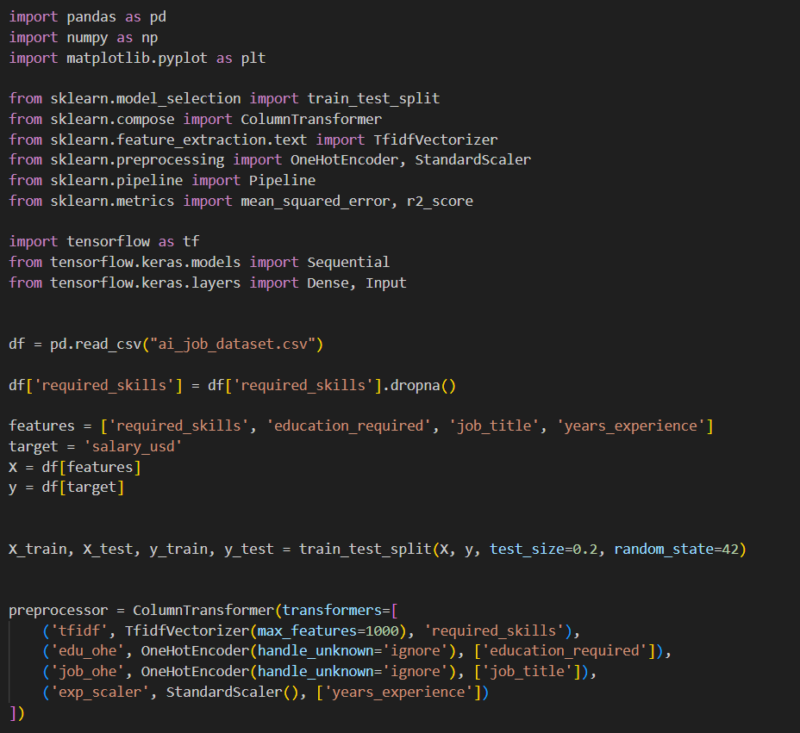
Source Code Preview

Slide 6
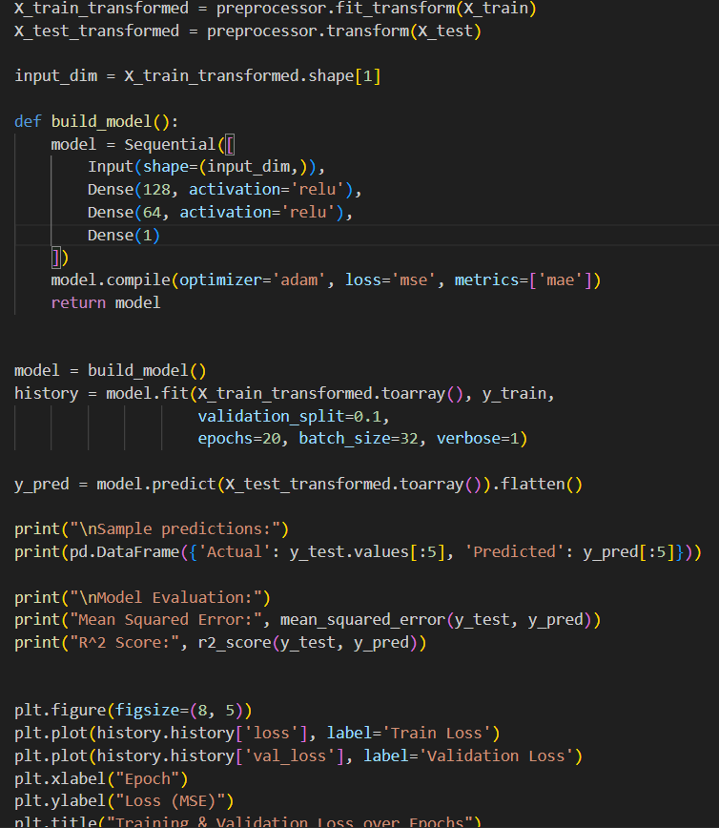
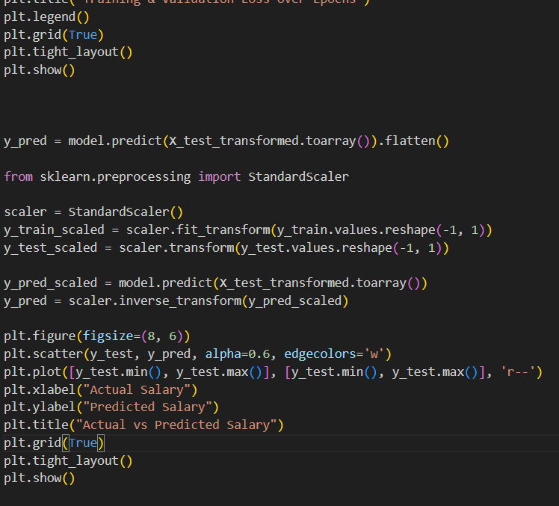
Source Code Preview

Slide 7
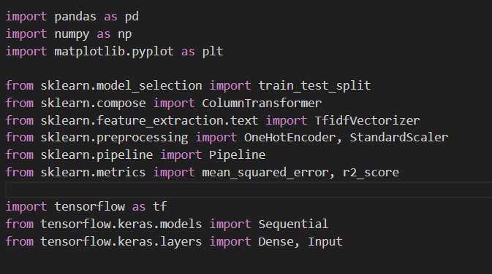
Importing Libraries
• pandas, numpy: Data handling
• sklearn: Preprocessing & splitting
• tensorflow: Building the deep learning model
• matplotlib: Visualization
Notes:
First of all I started with importing libraries

Slide 8
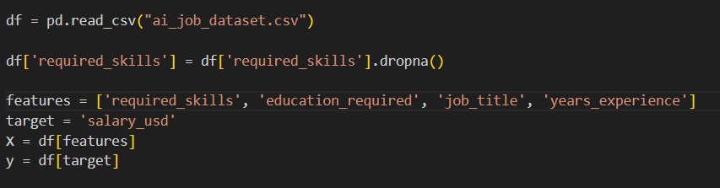
Data Loading
Read CSV file using pandas
Features: required_skills, education_required, job_title, years_experience
Target: salary_usd
Notes:
Then I loaded my data set from csv file and selected the desired features and target for the model

Slide 9
Data Spliting
• Use train_test_split from sklearn
• 80% training, 20% testing
Notes:
The dataset was then split into 2 sections with the 80% of majority being for training and the remaining 20% for testing

Slide 10
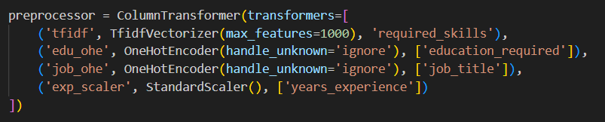
Data Preprocessing
• TF-IDF for text (required_skills)
• OneHotEncoder for categorical features
• StandardScaler for numerical features
Notes:
We use a ColumnTransformer to apply different preprocessing steps for different types of data:
TF-IDF for text-based skills
One-Hot Encoding for education and job titles
StandardScaler for numerical years of experience”

Slide 11
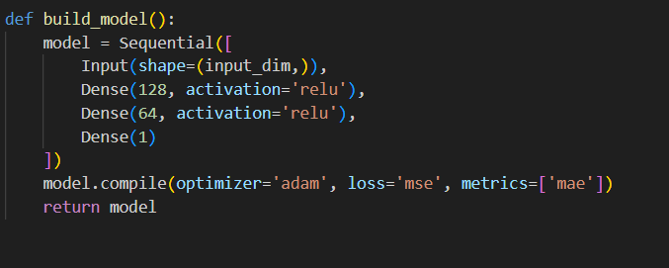
Building the Model
TensorFlow/Keras
Input: Dense(128) - Dense(64) - Dense(1)
• Activation: ReLU
• Optimizer: Adam
Notes:
We use TensorFlow’s Keras API to build a neural network.
It has two hidden layers with ReLU activation and one output layer for salary prediction.
The model uses Mean Squared Error as the loss function and Adam as the optimizer

Slide 12
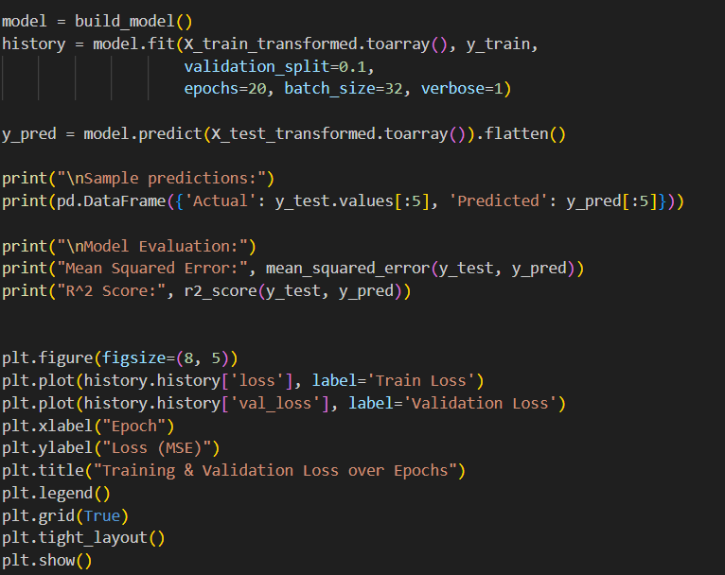
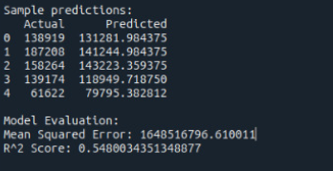
Model Training and Evaluation
Fit model with training data
• Use validation split of 10%
• Train for 20 epochs
• Loss: Mean Squared Error
-Sample output-
Notes:
The model is trained on the processed data using 20 epochs and a batch size of 32. We also reserve 10% of the training data for validation to monitor overfitting and underfitting.

Slide 13
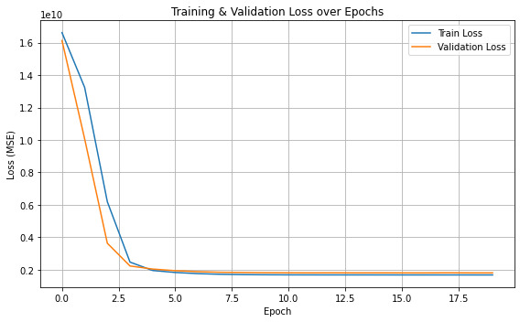
Model Training and Evaluation
Notes:
This graph shows the training and validation loss over each epoch. It helps us assess the model’s learning process and identify any signs of overfitting.
Since the graphs are close by to each other, it suggests good accuracy of the model.

Slide 14
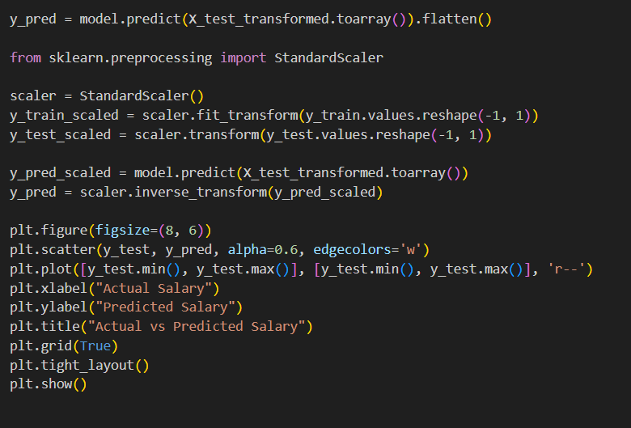
Scatter Plot (Actual vs Predicted)
Values have been standardised and normalised for the better accuracy of the model and plot quality.

Slide 15
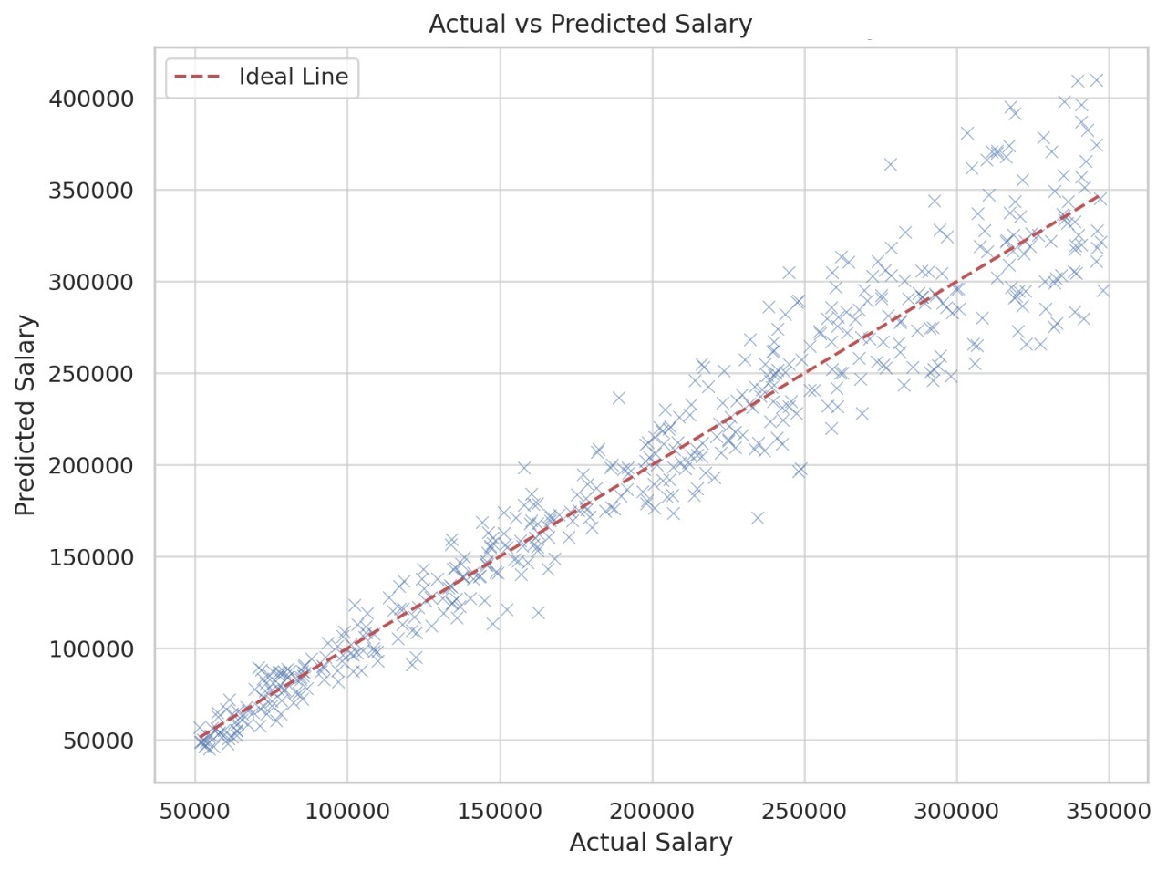
Scatter Plot (Actual vs Predicted)
Notes:
This scatter plot shows actual salaries versus predicted ones. Ideally, points should lie close to the red diagonal line, indicating good predictions.

Slide 16
Conclusion
• Successfully built a TensorFlow model
• Able to predict salaries from job features
• Visual tools help understand model behaviour

Slide 17
Thank you!

